Slide 1
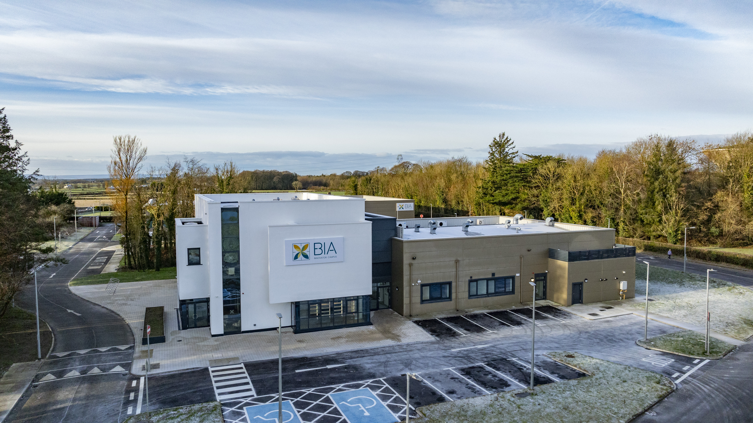
JOIN
OUR
TEAM!
Unique and rewarding opportunities to join BIA Innovator Campus
Project Coordinator
CLOSING DATE
Friday 6th September 2024
NATURE OF CONTRACT
This position will be offered on a 3-year fixed term contract to a suitable candidate. Applicants should note that a panel may be formed from which future vacancies may be filled.
WORKING WEEK
The normal working hours are 40 hours per week. This role will require a degree of flexibility as evening and weekend work apply, along with up to 30% foreign travel building relationships with key partners. Travel expenses within the scope of employment will be covered by BIA Innovator Campus.
LOCATION
The role will be based at BIA Innovator Campus, Teagasc, Mellows Campus, Athenry, Co. Galway, with the opportunity to work remotely available subject to agreement with line management. Candidates must have the right to live, work and travel in the EU. There is no visa sponsorship available for this role.
DEPARTMENT/FUNCTION AREA
EU & Internationalization

Slide 2
REPORTS TO
You will report directly to the GM, or a key person nominated by the GM and have responsibilities in delivering KPIs aligned with BIA Innovator Campus growth objectives.
DESCRIPTION OF POST
The BIA Project Coordinator will be an integral member of our team and will have specific responsibility for managing and handling key projects. The Project Coordinator will be supported by the Project Manager and will assist in managing project life cycles from start to finish. The successful candidate will continually strive to improve and grow the BIA relationships and partners pool with the ambition to transfer knowledge and learning to BIA members, tenants, and the food community.
ESSENTIAL QUALIFICATIONS/SKILLS - CANDIDATES MUST HAVE
Passion for food
Relevant bachelor’s degree or equivalent
2 years relevant experience
Strong communication and relationship building skills
A detail orientated nature
DESIRABLE QUALIFICATIONS/SKILL
Previous experience in a similar role desirable
Candidates must possess strong initiative coupled with the ability to operate effectively and appropriately in teams, in varied international cultural settings.
Excellent time-management and budget management skills and demonstrate an ability to multitask effectively.
KEY DUTIES
Provides project support to ensure BIA delivers on project actions
Monitors and reports on project status, budgets, and timetables
Engages with project stakeholder’s
Researching /Writing/Proofing content for project reports and publications
Development and delivery of project dissemination strategies
Communication and PR of projects
Representation of BIA in multiple settings

Slide 3
HEALTH
Each candidate must be in a state of health such as would indicate a reasonable prospect of ability to render regular and efficient service. To satisfy the requirement as to health, it will be necessary for the successful candidate, before they are appointed, to undergo a medical examination by a qualified medical practitioner to be nominated by BIA Innovator Campus CLG.
SALARY
35 – 45k DOE
Annual leave: 20 days per annum
APPLICATION PROCESS
Your CV and cover letter must be submitted by the advertised closing date and time. You will have to submit within the time advised; otherwise, your application will be deemed to be late and will not be considered.
This role is subject to a probationary period with reviews at months 3 and 6.
Character: Candidates shall be of good character and references shall be sought
BIA INNOVATOR CAMPUS CLG IS AN EQUAL OPPORTUNITIES EMPLOYER
How to
Please submit your:
Cover Letter
CV
LinkedIn profile link
To jobs@biainnovatorcampus.ie by Tuesday 24th October 2023. You will have to submit within the time advised, otherwise your application will be deemed to be late and will not be considered. This role is subject to a probationary period for 6 months with review at month 3.
Character: Candidates shall be of good character and references shall be sought.
apply
BIA INNOVATOR CAMPUS CLG IS AN EQUAL OPPORTUNITIES EMPLOYER

